Slide 1


Walmart - #BlackFriday & #CyberMonday Twitter Analytics
Team 1 – The 4 Nearest Neighbors
Adil Ashish Kumar, Daniel Byun, Ivy Zhou, Jiaqi Chen

Slide 2




Agenda
Background
Overview and Goal
Questions
Data
Research
Insights
Exploratory Data Analysis
Design
Implementation
Visualize
Notes:
Jiaqi

Slide 3



Background Information (news)
$7.4 billion
240%
17%
53%
Black Friday online sales in 2019
Percentage of revenue increase on Black Friday compared with normal business day (on-average)
Percentage increase of online sales for Black Friday year over year
Walmart’s percentage increase of online sales during Black Friday compared with last year
https://www.adobe.com/experience-cloud/digital-insights/holiday-shopping-report.html
Notes:
https://www.oberlo.com/ecommerce-wiki/black-Friday
https://www.bloomberg.com/news/articles/2019-11-30/online-sales-break-black-friday-record-as-clicks-beat-queues
https://www.bloomberg.com/news/articles/2019-11-30/online-sales-break-black-friday-record-as-clicks-beat-queues
https://www.adobe.com/experience-cloud/digital-insights/holiday-shopping-report.html
https://www.cnbc.com/2019/12/02/cyber-monday-shoppers-on-track-to-hit-a-record-9point4-billion-adobe-says.html
Jiaqi

Slide 4


Overview and Goal
Motivation
Goal
Black Friday and Cyber Monday are important opportunities for Walmart to boost sales and increase brand awareness
Walmart can better align itself for this opportunity if they can understand customer preferences and hottest trends
Walmart can also improve user experiences by understanding customers’ positive, negative and neutral opinions and their experiences
Ramp up social listening to drive marketing outreach
Learn about sentiment of twitter users who mentioned Black Friday OR Cyber Monday and Walmart in their tweets
Understand the most popular terms being mentioned together with Black Friday or Cyber Monday and Walmart to study customer preferences
Identify and capitalize on popularity of users to find marketing opportunities
Flexible and Reusable solution to track twitter activity and major trends

Slide 5


Questions
Initial Questions (focus on the tweets)
What are the most popular hashtags used while tweeting about Walmart and Black Friday or Cyber Monday?
Are these tweets positive, negative or neutral when mentioning Black Friday or Cyber Monday and Walmart?
What is the level of social activity on twitter over time during the Thanksgiving weekend?
01
Evolvement of Questions
New Questions (focus on the users)
What are the popular platforms being used to tweet?
Who are the most influential twitter users that mentioned Black Friday or Cyber Monday and Walmart?
Which users mentioned those terms the most amount of times?
02
Notes:
Jiaqi

Slide 6
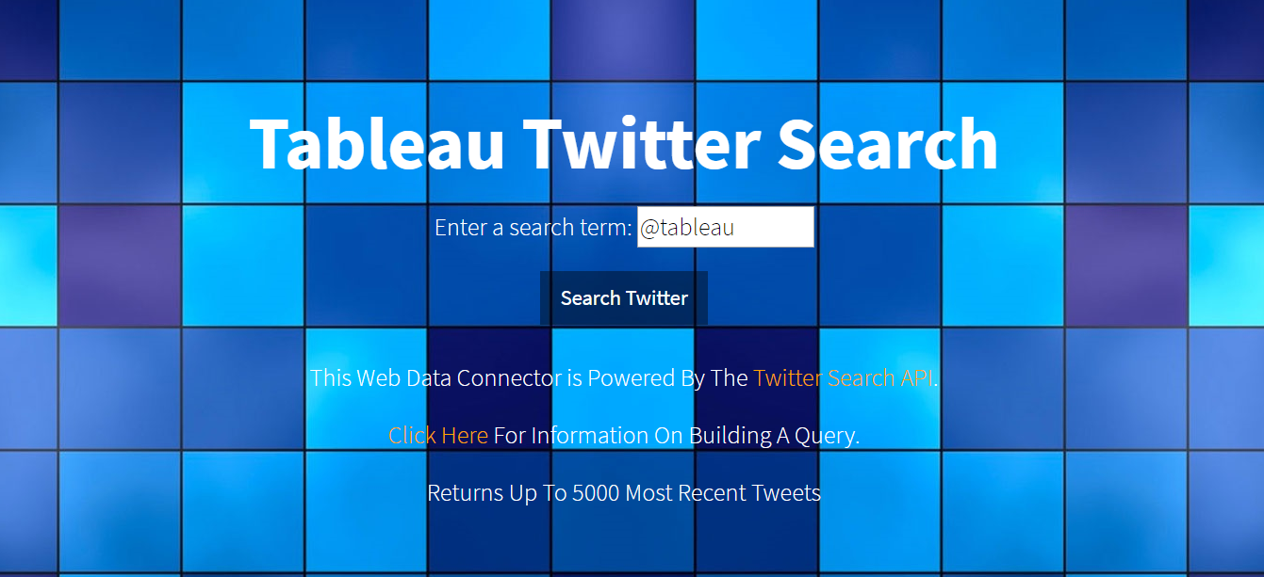
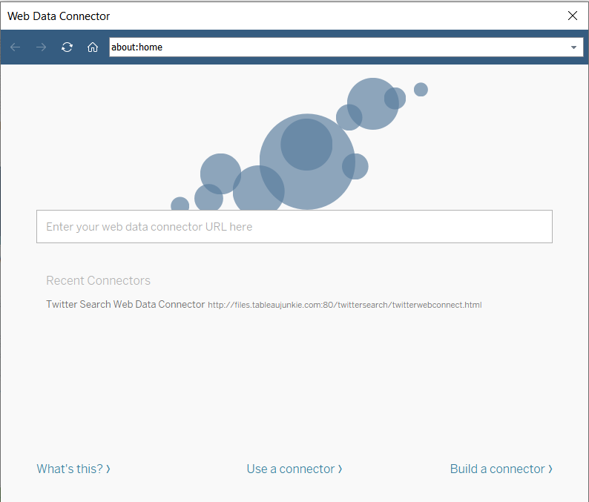





Data – Trial 1
Data Capturing
Source: Web Data Connector by
TableauJunkie using Twitter Search API
Search Term: #blackfriday walmart &
#cybermonday walmart
Issues:
1) Max limit of 5000 recent tweets
2) *Tweets truncated to 140 chars
3) Tweet URLs unavailable
4) Hashtags need to be extracted from tweets
Data Obtained
5000 tweets for search terms “#BlackFriday Walmart” and 2025 tweets for “#CyberMonday Walmart”
Tweet created time
Favorite count
Status Text*
User Followers Count
User Screen Name
http://files.tableaujunkie.com/twittersearch/twitterwebconnect.html
Notes:
Jiaqi

Slide 7
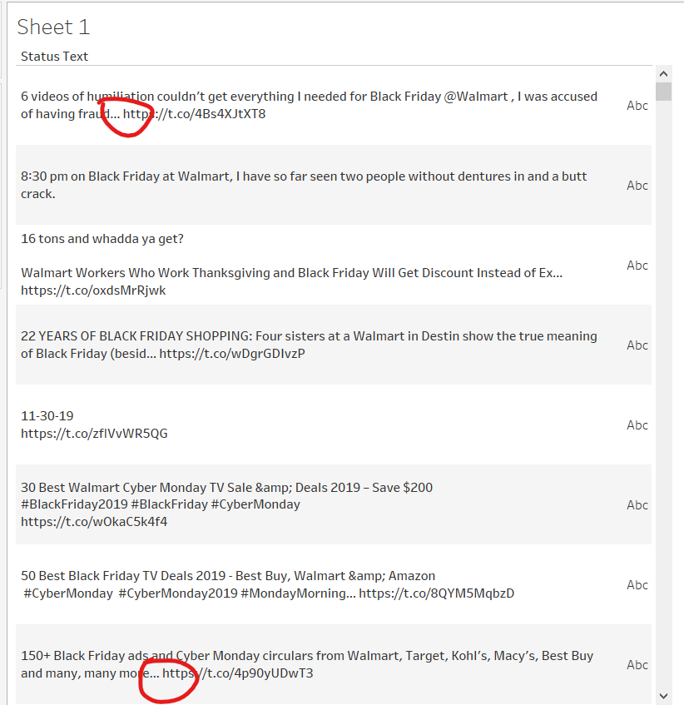
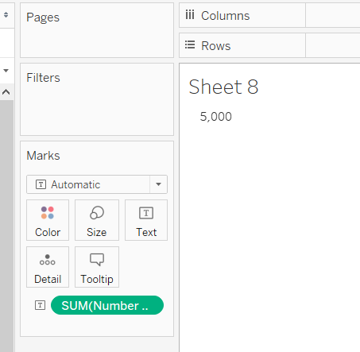
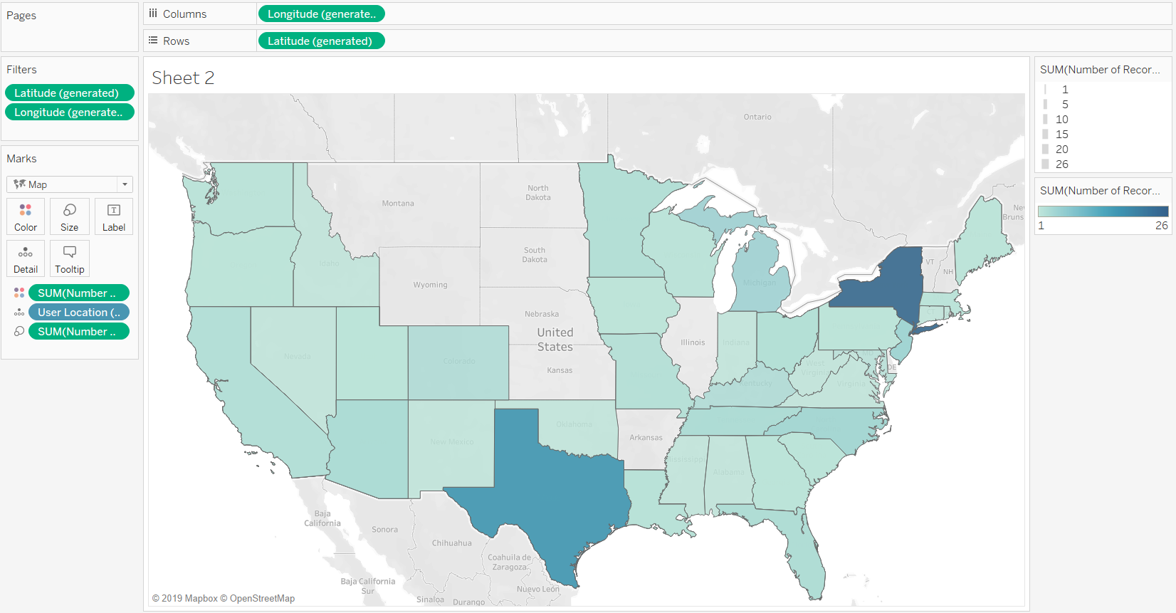
Exploratory Data Analysis – data trial 1
Only 5000 Tweets per pull in trial 1
Location data inconsistent – only about 200 tweets had location data
Truncated text in trial 1

Slide 8
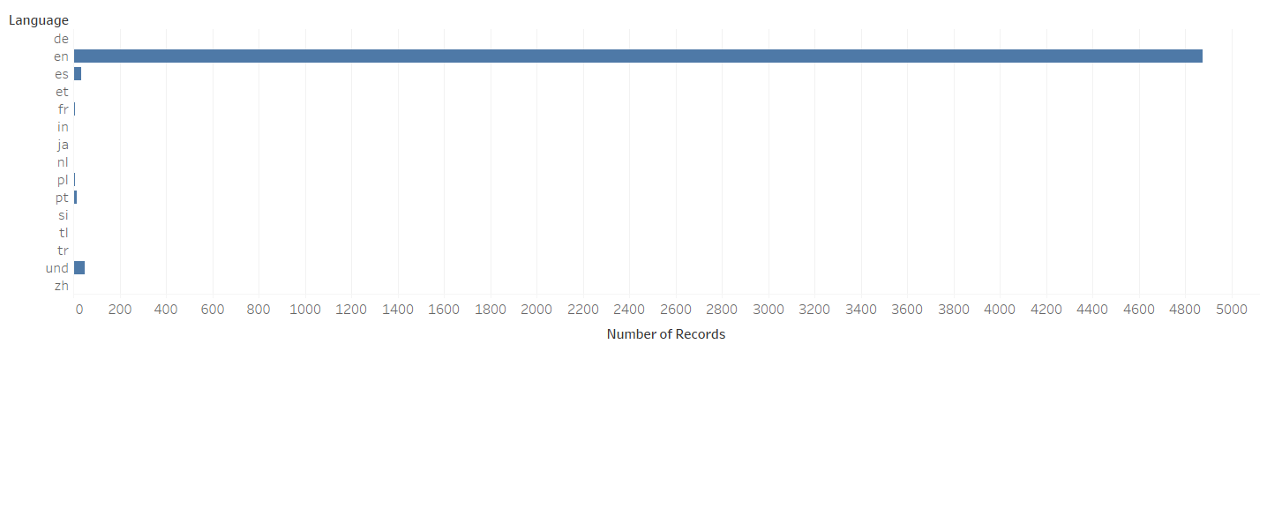
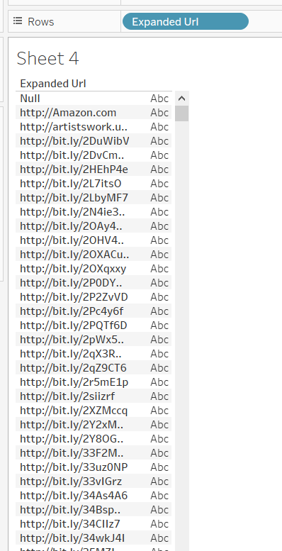
Exploratory Data Analysis – data trial 1
Language data not of much use – almost all tweets in english
Twitter URLs missing

Slide 9
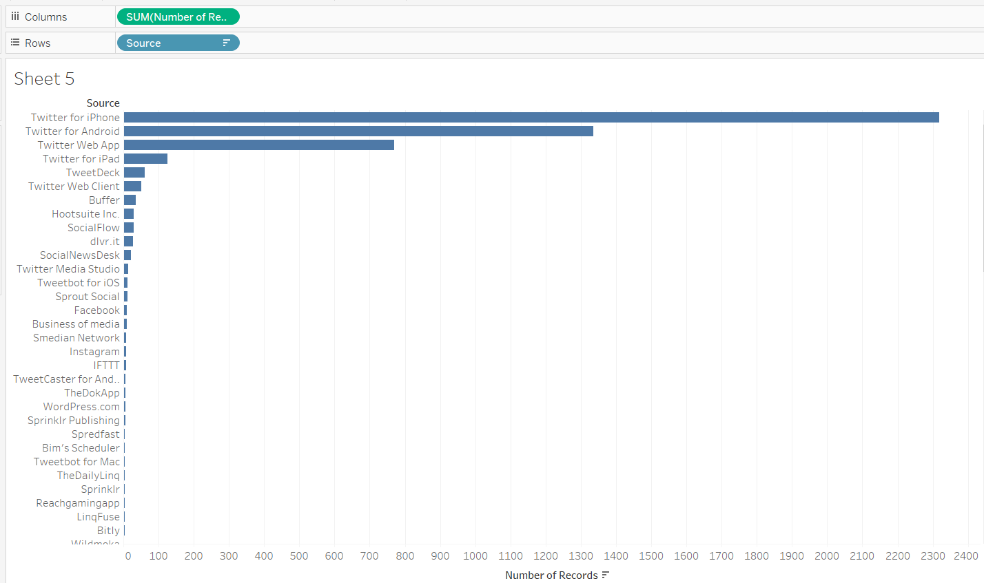
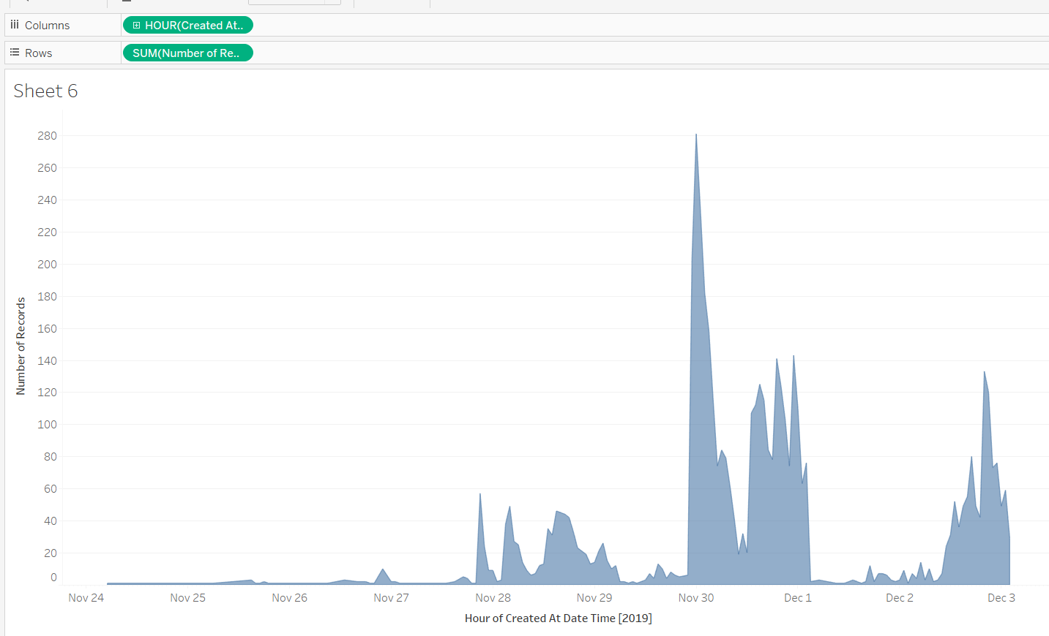
Exploratory Data Analysis– data trial 1
Only Top sources important
Clear spike in activity during black friday

Slide 10
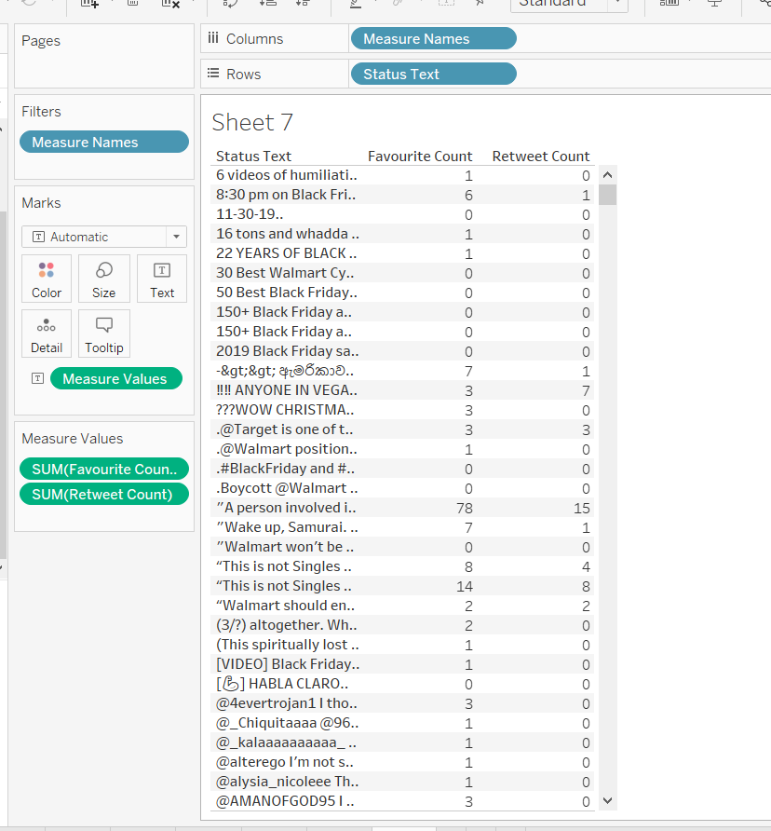
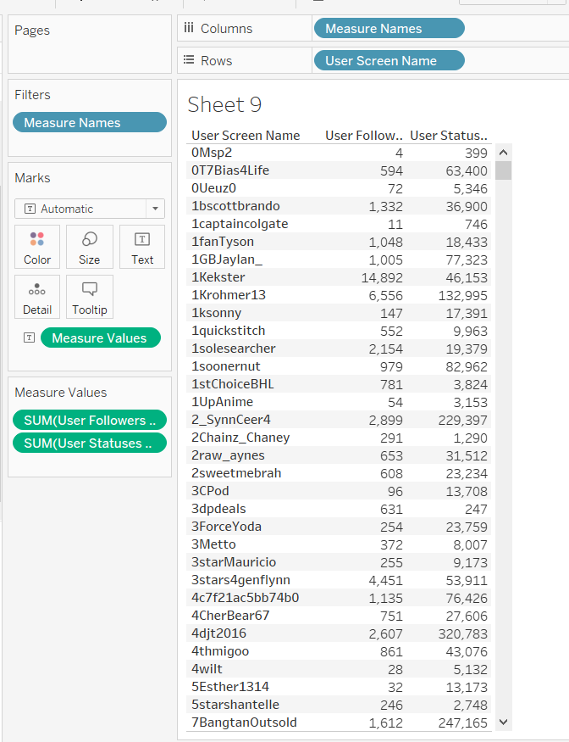
Exploratory Data Analysis– data trial 1
Both tweet statistics and user statistics are available and consistent

Slide 11


Data – Trial 2
Data Capturing
Source: rtweet package to scrape tweets
in R using Twitter Search API
Search Term: #blackfriday walmart &
#cybermonday walmart
Advantages:
1) Max limit of 18000 recent tweets
2) Full tweet text available
3) Tweet URLs available
4) Hashtags available in data
Data Obtained
6739 tweets for search terms “#BlackFriday Walmart” and 2311 tweets for “#CyberMonday Walmart”
Tweet created time
Favorite count
Status Text
User Followers Count
User Screen Name
https://rtweet.info/
Notes:
Jiaqi

Slide 12
Exploratory Data Analysis Summary
Based on the EDA, we finalized on what was useful to show on the dashboard and what was not.
We then chose to use python(observed better polarity prediction compared to R packages we tried) to extract polarity for each tweet.
Ideally we could use TabPy, which is similar to Rserve, and have no external dependencies outside of Tableau.
However Tableau public does not allow to post dashboards with external connections, so we decided to run the python code outside of tableau
Initially, hashtags had to be extracted using code and then joined back into dataset.
Once we used rtweet(we were more familiar with R for data processing) to scrape data, we reran the EDA charts on new data and saw that data was much better in comparison to what we had from trial 1, and had more data points
A bit of preprocessing in R was needed to convert data into a dataframe that can be output to csv. Hashtags were in list format (each tweet is a row, and hashtag column had a list of hashtags for each tweet)

Slide 13
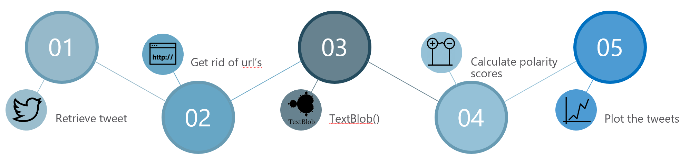
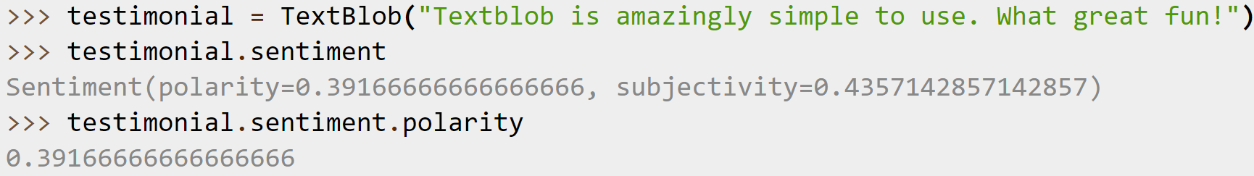
Data – Sentiment Analysis in python
https://textblob.readthedocs.io/en/dev/index.html#

Slide 14
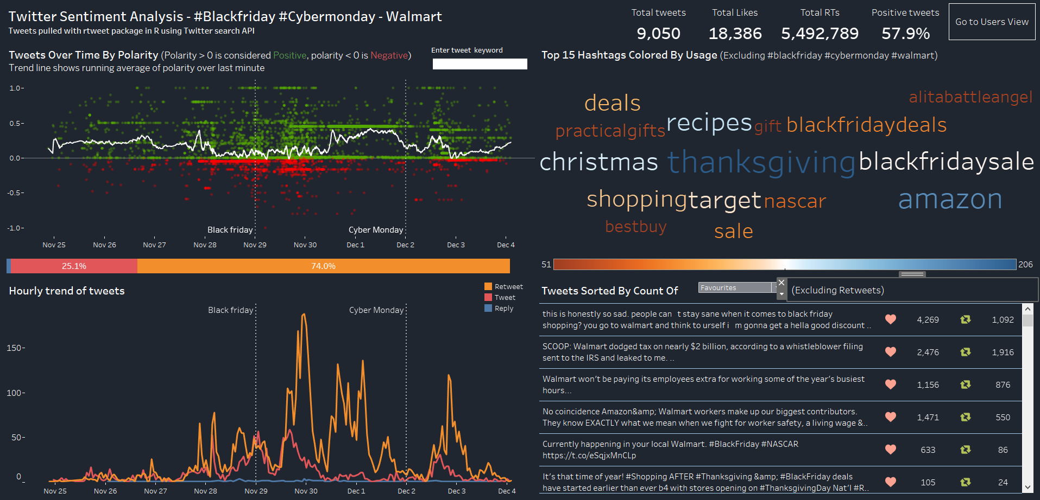
Design Evolution Dashboard #1 Overview
Overall Stats
To Dash-board #2
Popularity & Sentiment
Hashtag
Hourly Trend
Tweets Detail

Slide 15
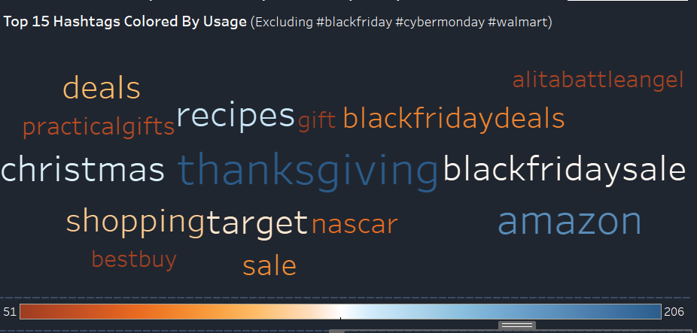


Design Evolution Hashtags
What are the most popular hashtags used?
Used a word cloud since it is an effective/innovative way to convey commonly used words, combined with size and color to highlight popular words
Alternate Charts considered: Bar Chart – all time winner or tree map. Bar chart would be an equally good option
Design:
Used a diverging scale of 2 colors since single color scale was not showing differences between words distinctly
Action:
Select a word all the other charts will filter accordingly
Notes:
What are the different visualizations you considered?
Justify the design decisions you made using the perceptual and design principles you learned in the course. Did you deviate from your proposal?

Slide 16
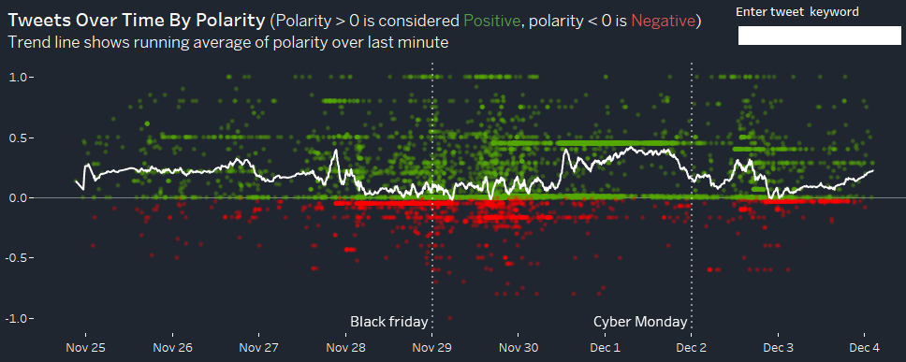
Design Evolution Popularity & Sentiment
Are these tweets positive, negative or neutral ?
Chose time series dot plot since it was easy to see concentration of tweets over time along with sentiment, with reference lines indicating major event occurences
Design:
Positive Tweets: Green
Negative Tweets: Red
The running average polarity in last minute: White trend line
Action:
Search any keyword we prefer by the search bar at the top, filters all other charts

Slide 17
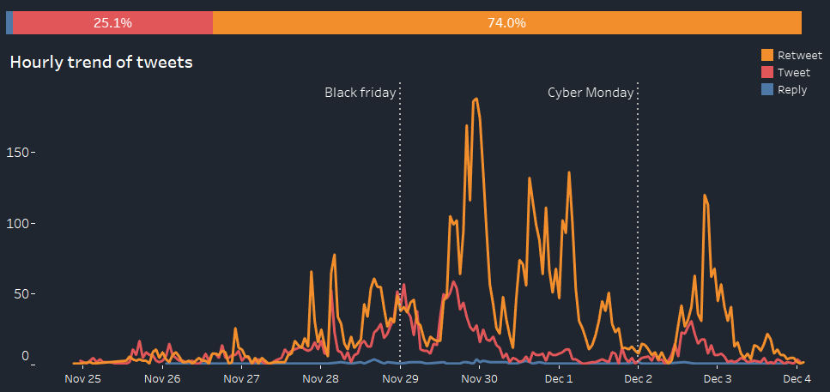
Design Evolution Hourly Trend & Tweet Type
What are critical points in time when social media activity increases? Are certain types of tweets more common?
Alternative chart: Area chart, however line chart is best to show trends over time, especially for comparing multiple categories
Design:
Tweets, retweets and Replies are marked in different color trend lines.
The stacked bar on the top shows the overall percentage of each type of tweets.

Slide 18
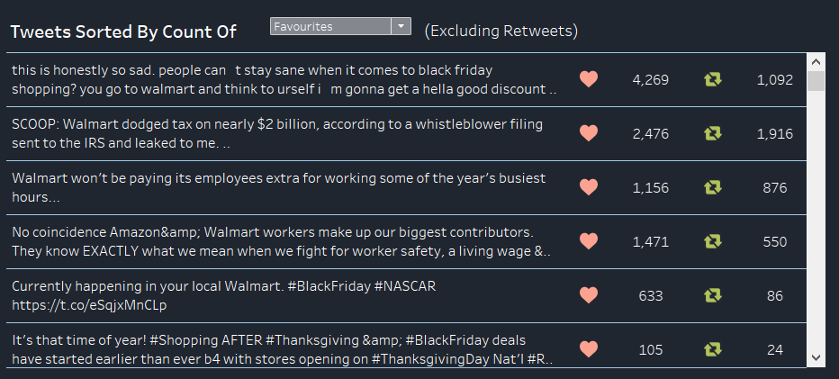

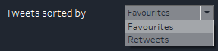
Design Evolution Tweets Detail
Identify the most popular tweets by favorites or retweets
Alternate chart: Since we want to see the content of a tweet, the table with tweet statistics is the best and simplest way to visualize
Design:
Shows all tweets by the hashtag we select.
Action:
Choose the sorting of Tweets:
By number of favorites OR
By number of retweets
Selecting a tweet opens up the tweet in browser window

Slide 19
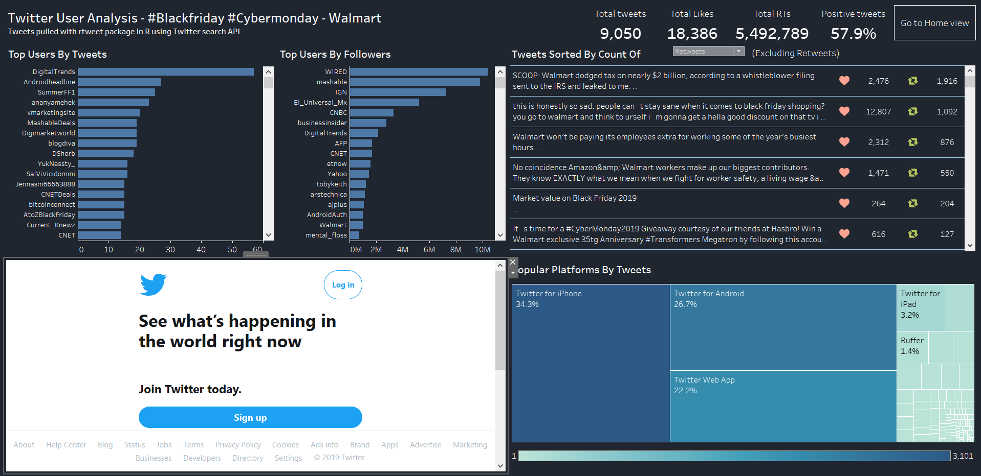
Design Evolution Dashboard #2 Overview
To Dash-
board #1
Top Users by Tweets &
by Followers
Tweets
Detail, can filter by fav/RT
User Website/tweets
Tree Map for
Platform
Notes:
What are the different visualizations you considered?
Justify the design decisions you made using the perceptual and design principles you learned in the course. Did you deviate from your proposal?

Slide 20
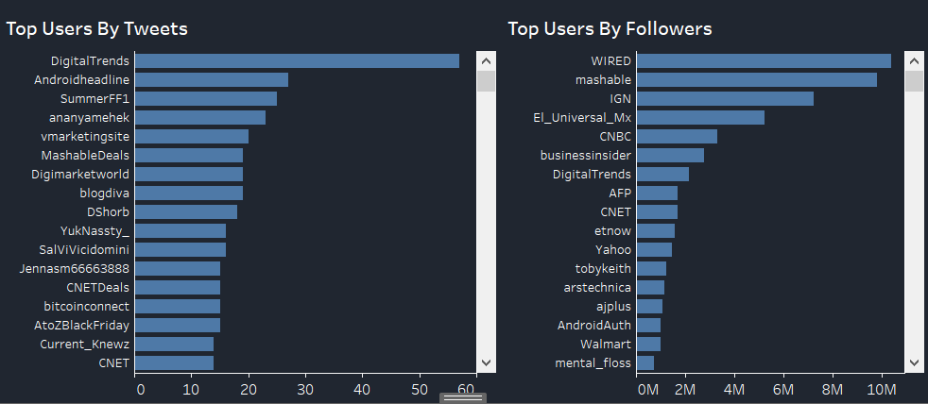
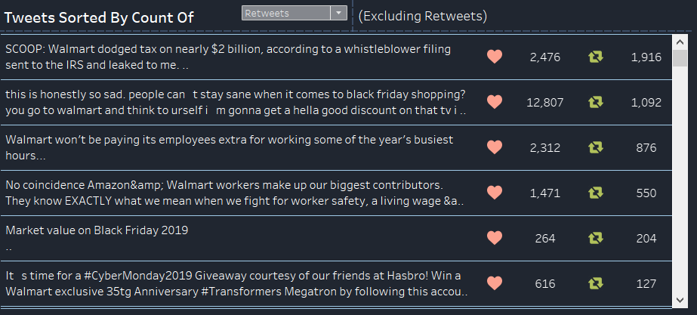
Design Evolution Top User
Who are the most influential twitter users who tweeted #BlackFriday or #CyberMonday and #Walmart?
Design:
Chart on left:
Bar chart of users sorted by number of tweets
Chart on right:
Bar chart of users sorted by number of followers
Alternative chart – Tree map
Action:
Select the user lead to the website
Selecting user also shows their tweets, and clicking the tweet opens up the tweet in URL window

Slide 21
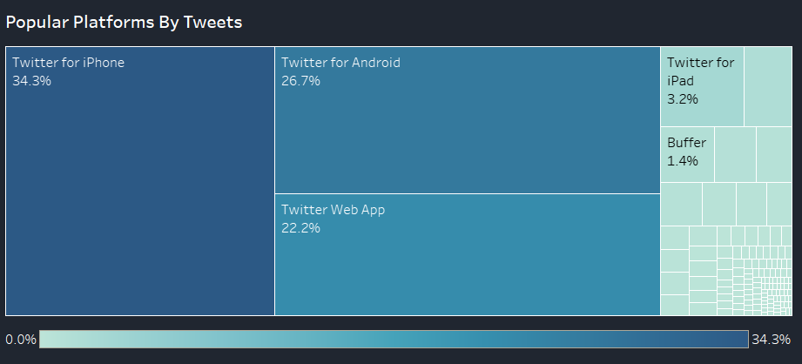
Design Evolution Type of Platform
What platforms are users using for those tweets?
Alternatives – bar chart, pie(just kidding)
A tree map is created to show the weight of different platforms:
iPhone, Android, Twitter Web App, etc.

Slide 22
Dashboard Demo

Slide 23
Implementation
Potential use cases would be in the marketing and social listening dpeartments within Walmart
Our current dashboard is a fully functioning tweet analyzer and could be used for any hashtag that is searched
This makes our dashboard flexible and reusable for any twitter analytics application
However, certain changes can be made to make the overall implementation completely reside in tableau
Tweet scraping can be done within Tableau using a premium Twitter search API that would use a tableau web data connector
This would allow pulling all historic data for any hashtag with no restrictions
Then an external connection like Rserve or Tabpy can be used to run sentiment analysis to extract tweet polarity (assuming we do not need to publish it to Tableau public)
The dashboard can be reused with almost no changes for pretty much any hashtag, since the field names and types of twitter data is consistent for any data scrape
Notes:
Describe the intent and functionality of the interactive visualizations you implemented. Provide clear and well-referenced images showing the key design and interaction elements.

Slide 24
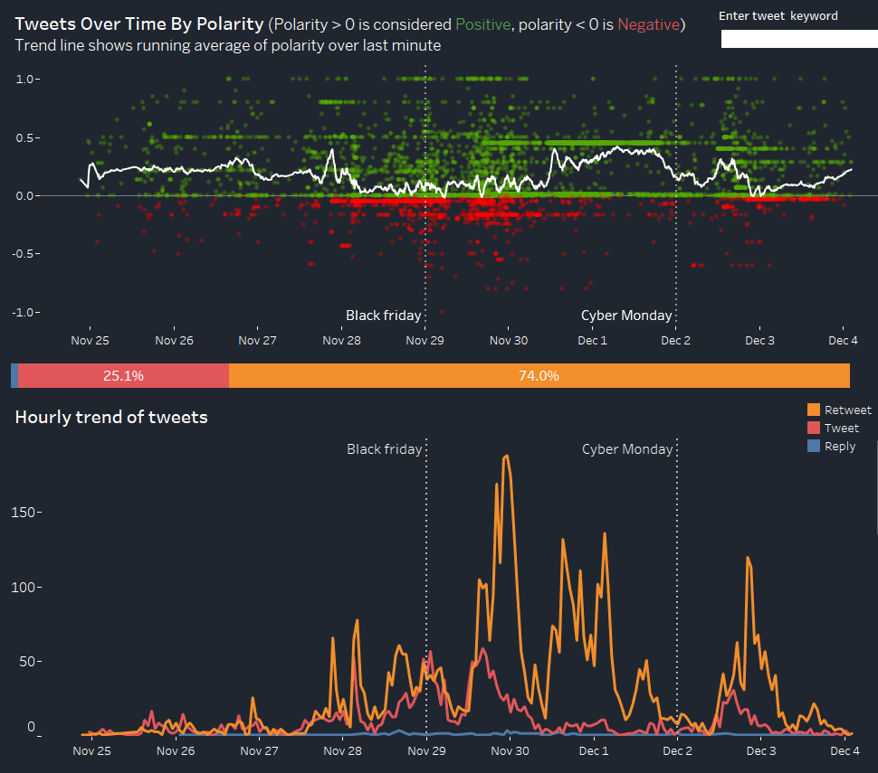
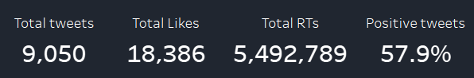
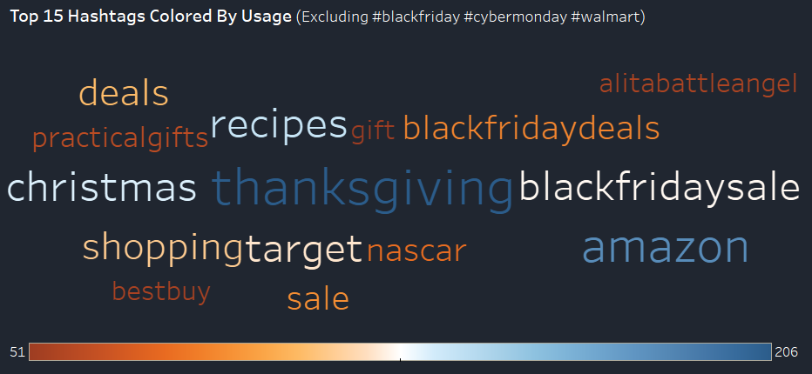
Insights
Clear spike in twitter activity just after black friday begins
Majority of the tweets were retweets
Overall polarity is positive, but only about 57% of tweets, which is not a great insight for walmart
More activity seen around black friday compared to cyber monday
Thanksgiving was overall the most popular hashtag, which makes sense
Amazon was second most popular, a big competitor to Walmart
Notes:
What did you learn about the data by using your visualizations? How did you answer your questions? How well does your visualization work, and how could you further improve it?

Slide 25
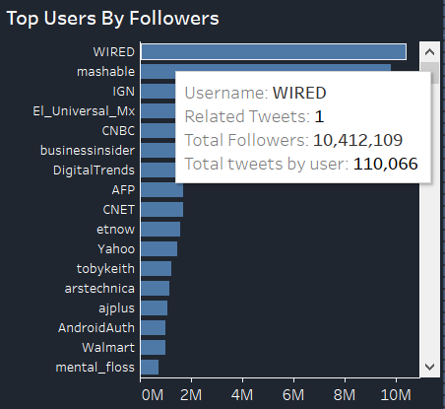
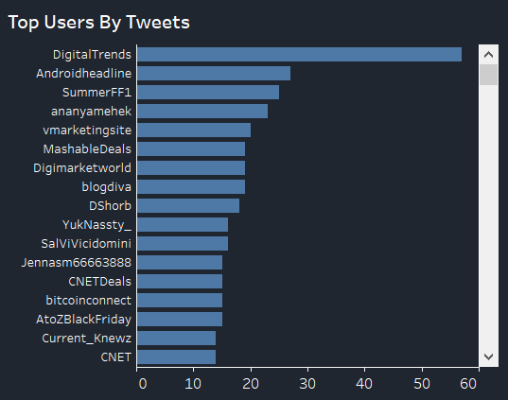
Insights
Wired is a very popular twitter handle but has only 1 tweet mentioning walmart.
Top users by tweets shows that a lot of the users are companies and not individuals – Androidheadline, digitaltrends etc. Walmart can do an attribution analysis to analyze effect of their tweets on social activity and sentiment
Identifying popular and active users who are pro walmart could lead to potential partnership opportunities for marketing deals and reach more users

Slide 26
Improvements
- Implement dashboard completely on tableau with no other dependencies
- Create a social network with the tweet using retweets and similar hashtags as indications of a connection
- Delve into the reason behind the sentiment fluctuation in tweets
- Get past data about Walmart and Black Friday or Cyber Monday to compare and improve the time series data
- Get more information about twitter users (Demographics, age, gender)

